Slide 1
Continuing Education: Energy Methods
Introduction to Strain Energy
Displacement Methods
Virtual Work
Total Potential Energy
Castigliano’s 1st Theorem
Force Methods
Complementary Virtual Work
Total Complementary Energy
Castigliano’s 2nd Theorem

Slide 2
Energy Methods Are Based on Variational Mechanics
VECTOR MECHANICS
Equilibrium
Compatibility
Strain-Displacement
Compatibility Condition
Constitutive Laws
VARIATIONAL MECHANICS
Less Physically Obvious
More Mathematical
Tremendous Simplification
Leads to Finite Element

Slide 3
Strain Energy of Deformation is the Basis of Energy Methods
First Law of Thermodynamics
Adiabatic Process
Change in
Stored Energy
Strain Energy of Deformation, U
Strain Energy per Unit Volume, U
Solid
Work Done By
External Forces
During Loading Movement of CG Nominal
Material Elastic/ No Hysteresis
Heat Transfer
From Surroundings
Notes:
Solid
Support Forces
External Tractions and Body Forces applied in a QUASI-STATIC Manner (eliminate dynamic effects)

Slide 4
Strain Energy Increment Computed Directly From σ-ε
y
The Increment of Work Done
0
z
Higher Order Terms
x
0
0
Equilibrium

Slide 5
Strain Energy Increment Computed Directly From τ-γ
y
The Increment of Work Done
0
0
0
Higher Order Terms
z
x

Slide 6
For Isotropic Materials and Can Be Added
Notes:
Sigma’s and Gamma’s independent because material is Isotropic

Slide 7
The Total Strain Energy for Elastic-Isotropic Material

Slide 8
EXAMPLE 1: Computing Strain Energy
Shown is a long prismatic bar loaded at the ends by axial forces along the centroidal axis of the bar. Determine the Strain Energy in the bar.
F
F
L

Slide 9
SOLUTION 1: Computing Strain Energy
F
F
L

Slide 10
EXAMPLE 2: Computing Strain Energy
Shown is a long prismatic bar loaded at the ends by an axial displacement. Determine the Strain Energy in the bar.
L+δ
L

Slide 11
SOLUTION 2: Computing Strain Energy
L+δ
L

Slide 12
SOLUTION 2 Continued: Computing Strain Energy
L+δ
L

Slide 13
The Strain Energy Density for a One-Dimensional State
Linear Materials

Slide 14
First Mind Refresher
Can you think of a way in which you can put a sheet of newspaper on the floor so that when two people stand face to face on it, they won’t be able to touch one another? Cutting or tearing the paper is not allowed. Neither is tying up the people or preventing them from moving.

Slide 15
Starting with the Displacement Methods Referred to as Virtual Work.
Introduction to Strain Energy
Displacement Methods
Virtual Work
Total Potential Energy
Castigliano’s 1st Theorem
Force Methods
Complementary Virtual Work
Total Complementary Energy
Castigliano’s 2nd Theorem

Slide 16
The Principle of Virtual Work is Based on Virtual Displacements
Small Displacements
Arbitrary Displacements
Hypothetical change in position of a particle without violating any constraints on the particle
No attending elapse of real time

Slide 17
The Virtual Displacement Occurs With No Change In Time
Notes:
Virtual displacement from P to P’
Position vector to Point P’ the Varied Position Vector

Slide 18
Infinitesimal Deformation is a Virtual Displacement Field
A virtual displacement field is a single-valued, continuous vector field representing a hypothetical movement of a deformable body consistent with the constraints present and with on change in time.
Notes:
Introduction to the concept of a varied function
Variation of G is del G
Displacements at constraints zero
Displacements and rotations at wall zero

Slide 19
Virtual Work In Terms of Body Forces and Tractions
Virtual Displacements [L]
Traction Force [F/L³]
Body Force [F/L³]

Slide 20
Virtual Work for a Deformable Body is NOT Zero: 1D Case
1
2

Slide 21
Virtual Work for a Deformable Body is NOT Zero: 1D Case
1
2
Equilibrium
0

Slide 22
Virtual Work for a Deformable Body is NOT Zero: 1D Case
1
2

Slide 23
The General Expression for Virtual Work
Virtual Displacements [L]
Traction Force [F/L³]
Body Force [F/L³]

Slide 24
EXAMPLE 3: Virtual Work
For the two member pin jointed truss shown, apply the principle of virtual work to determine the forces in the members.
L
L
α
α
β

Slide 25
SOLUTION 3: Virtual Work in Vertical Direction
B
C
L
a
α
α
A
β
1

Slide 26
SOLUTION 3: Virtual Work in Horizontal Direction
B
C
L
b
α
α
A
β
2

Slide 27
SOLUTION 3: Force In AB & AC Found
1
B
C
2
L
α
α
A

Slide 28
EXAMPLE 4: Virtual Work
For the two member pin jointed truss shown, introduce a linear elastic constitutive law and determine the displacement of Point A.
L
L
α
α
β

Slide 29
SOLUTION 4: Virtual Work in Vertical Direction
a
B
C
L
α
α
A

Slide 30
SOLUTION 4: Virtual Work in Vertical Direction
b
B
C
L
α
α
A

Slide 31
Mind Refresher 2
If a lily doubles in size every day and on the 20th day the lily takes up the whole pond, on what day did the lily take up half the pond.

Slide 32
The Force Method Referred to as Total Potential Energy
Introduction to Strain Energy
Displacement Methods
Virtual Work
Total Potential Energy
Castigliano’s 1st Theorem
Force Methods
Complementary Virtual Work
Total Complementary Energy
Castigliano’s 2nd Theorem

Slide 33
Stresses and Strains are Linked Through Constitutive Law
Notes:
Stress are not related to virtual strains and virtual displacements in the development of the principle of virtual work

Slide 34
Virtual Work Expression used to Define the Variation of Potential Energy
Notes:
From the previous page, the right hand side is the variation of the Strain Energy U
The Total Potential Energy Principle satisfies Equilibrium, some Elastic Constitutive Laws, and Kinematic Compstibility

Slide 35
EXAMPLE 5: Total Potential Energy
Using the method of Total Potential Energy, find the displacement of point A of the truss shown (Previous Example)
L
L
α
α
β

Slide 36
SOLUTION 5: Total Potential Energy
a
B
C
L
α
α
A
b
Notes:
Strain Energy U based on n-member truss, linear elastic, one-dimensional state of stress
Constitutive Law introduced in last step

Slide 37
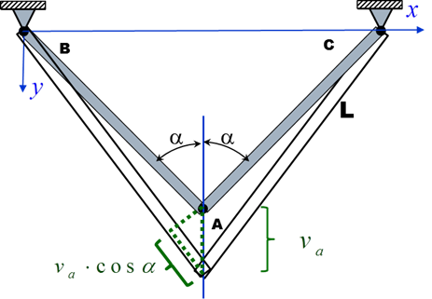
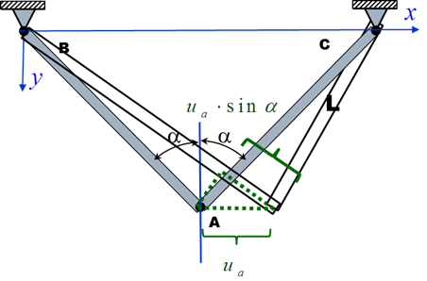
SOLUTION 5: Total Potential Energy
c
Notes:
Strain Energy U based on n-member truss, linear elastic, one-dimensional state of stress
COMPATIBILIITY satisfied through strain-displacement relationships

Slide 38
SOLUTION 5: Total Potential Energy

Slide 39
General Application of Total Potential Energy Requires Functionals
In the study of Particle and Rigid Body Mechanics the Potential Energy is a Function
In the previous example the Total Potential Energy is a Function
In a General Elastic Body (Beams, Plates, and so on) the Total Potential Energy is a Functional
Extremizing Functionals requires the Calculus of Variation

Slide 40
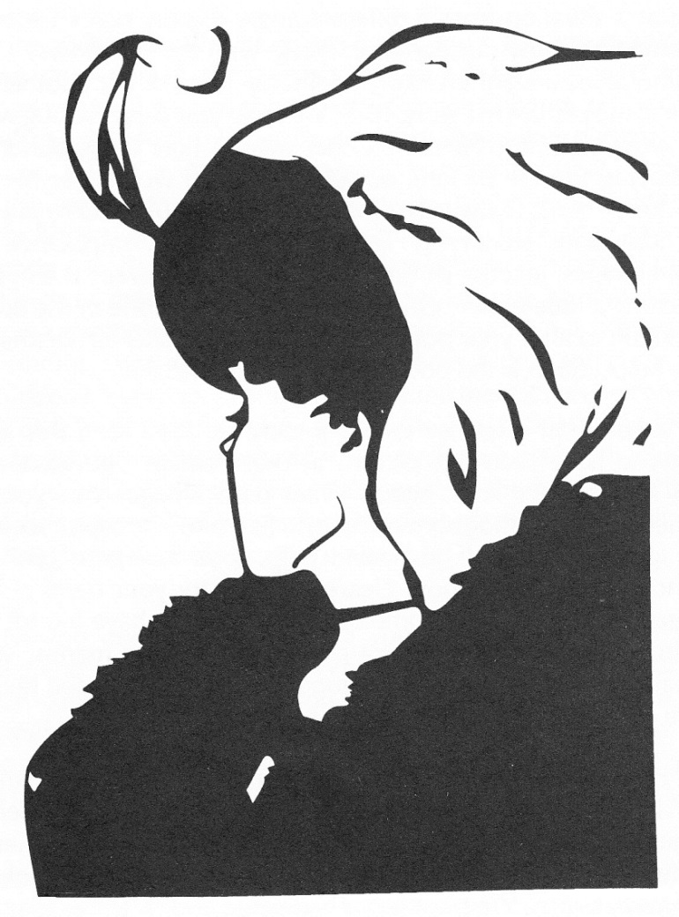
Mind Refresher 3

Slide 41
The Displacement Method Referred to as Castigliano’s 1st Theorem
Introduction to Strain Energy
Displacement Methods
Virtual Work
Total Potential Energy
Castigliano’s 1st Theorem
Force Methods
Complementary Virtual Work
Total Complementary Energy
Castigliano’s 2nd Theorem

Slide 42
Body With Rigid Supports Subjected to Generalized Loads that Result in Generalized Deformations
Elastic Body With Rigid Supports
Generalized Loads Independent of each other,
Forces
Moments
Generalized Deformations,
Displacements (Collinear with Forces)
Rotations (Collinear with Moments)
Notes:
Elastic Body with Rigid Supports acted on by Generalized Forces and Moments

Slide 43
Potential Energy U Expressed in terms of Generalized Displacements
Castigliano’s First Theorem
Since δ_{I}’s are independent

Slide 44
EXAMPLE 6: Castigliano’s First Theorem
Using Castigliano’s First Theorem to find the displacement of point A of the truss shown (Previous Example)
L
L
α
α
β

Slide 45
Solution 6: Castigliano’s First Theorem

Slide 46
EXAMPLE 7: Castigliano’s First Theorem
Rigid Plate
Determine the relationship between the displacement Δ of the rigid end cap and the applied load P.
A₁
Δ
A₂
L

Slide 47
SOLUTION 7: Castigliano’s First Theorem
Rigid Plate
A₁
Δ
A₂
L

Slide 48
EXAMPLE 8: Castigliano’s First Theorem
Determine the total displacement Δ given the applied load P.
Δ₁
L₁
Δ₂
L₂

Slide 49
SOLUTION 8: Castigliano’s First Theorem
Δ₁
L₁
Δ₂
L₂
Δ=Δ₁+Δ₂

Slide 50
Mind Refresher 4
In the biblical story of Noah and the ark …

Slide 51
The Force Method Referred to as Complementary Virtual Work.
Introduction to Strain Energy
Displacement Methods
Virtual Work
Total Potential Energy
Castigliano’s 1st Theorem
Force Methods
Complementary Virtual Work
Total Complementary Energy
Castigliano’s 2nd Theorem

Slide 52
Complementary Virtual Work In Terms of Body Forces and Tractions
Displacements [L]
Virtual Body Force [F/L³]
Virtual Traction Force [F/L³]

Slide 53
Complementary Virtual Work for a Deformable Body is NOT Zero: 1D Case
1
2

Slide 54
Complementary Virtual Work for a Deformable Body is NOT Zero: 1D Case
1
2
Equilibrium
0

Slide 55
Complementary Virtual Work for a Deformable Body is NOT Zero: 1D Case
1
2

Slide 56
The General Expression for Complementary Virtual Work
Displacements [L]
Virtual Traction Force [F/L³]
Virtual Body Force [F/L³]

Slide 57
EXAMPLE 9: Complementary Virtual Work
Using Complementary Virtual Work to find the displacement of point A of the truss shown (Previous Example)
L
L
α
α

Slide 58
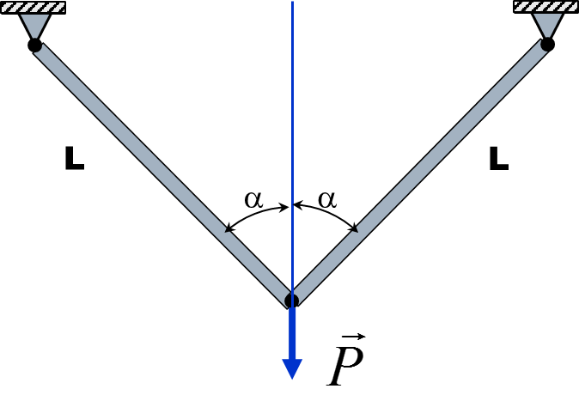
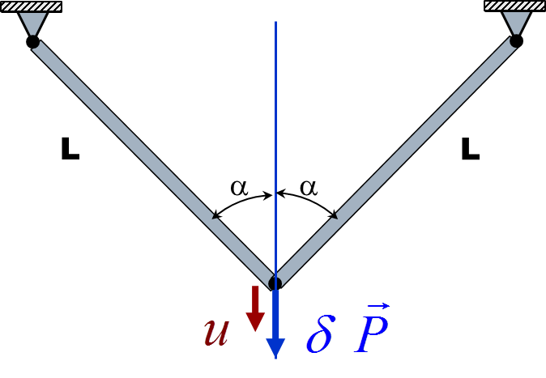
SOLUTION 9: Complementary Virtual Work
a
b
c

Slide 59
SOLUTION 9: Complementary Virtual Work

Slide 60
EXAMPLE 10: Complementary Virtual Work
For linear elastic behavior of the members, all of whom have identical cross section and elastic moduli, find the vertical deflection Δ of the joint C from the given external forces P₁, P₂, and P₃.
D
4
8
B
E
5
1
3
7
9
A
F
2
C
6

Slide 61
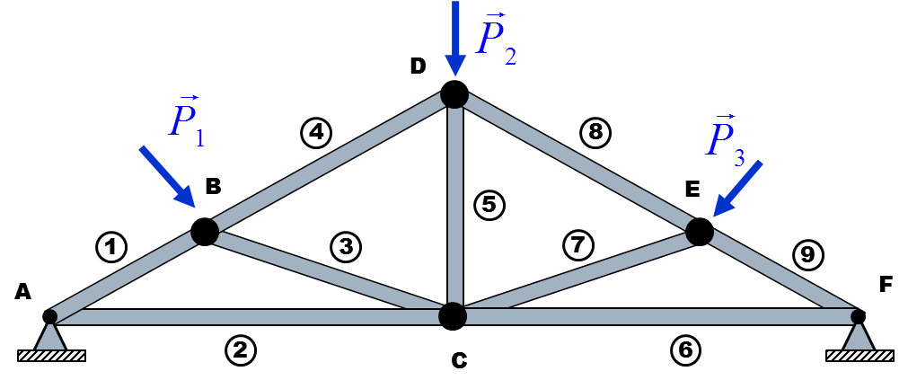
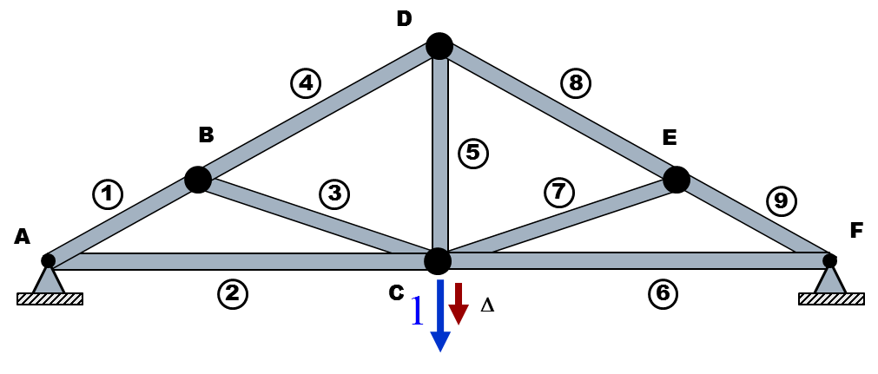
SOLUTION 10: Complementary Virtual Work
a
b

Slide 62
SOLUTION 10: Complementary Virtual Work

Slide 63
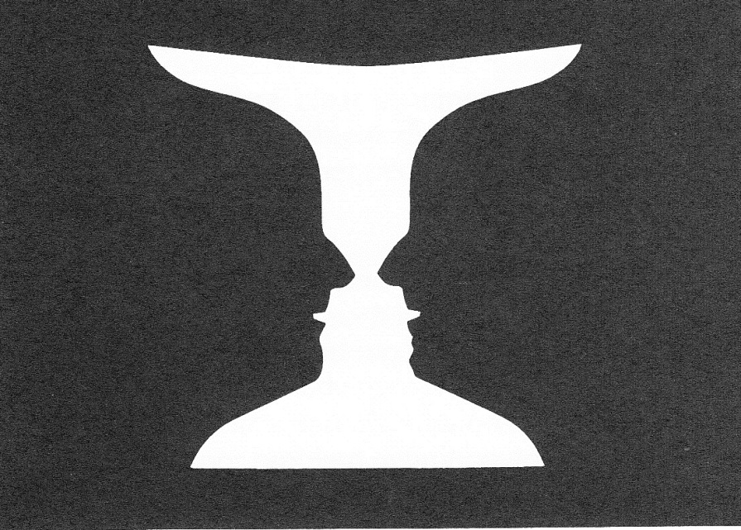
Mind Refresher 5

Slide 64
The Force Method Referred to as Total Complementary Energy.
Introduction to Strain Energy
Displacement Methods
Virtual Work
Total Potential Energy
Castigliano’s 1st Theorem
Force Methods
Complementary Virtual Work
Total Complementary Energy
Castigliano’s 2nd Theorem

Slide 65
Stresses and Strains are Linked Through Constitutive Law
Notes:
Stress are not related to virtual strains and virtual displacements in the development of the principle of virtual work

Slide 66
Virtual Work Expression used to Define the Variation of Complementary Potential Energy
Notes:
From the previous page, the right hand side is the variation of the Strain Energy U
The Total Potential Energy Principle satisfies Equilibrium, some Elastic Constitutive Laws, and Kinematic Compstibility

Slide 67
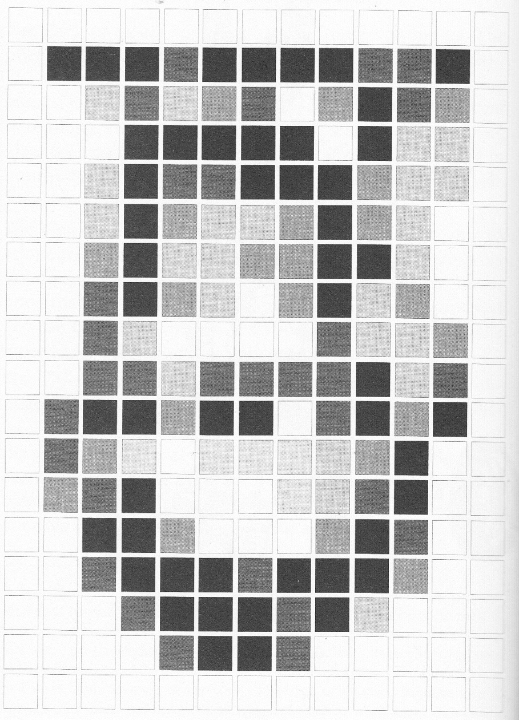
Refresher 6

Slide 68
The Force Method Referred to as Castigliano’s 2nd Theorem.
Introduction to Strain Energy
Displacement Methods
Virtual Work
Total Potential Energy
Castigliano’s 1st Theorem
Force Methods
Complementary Virtual Work
Total Complementary Energy
Castigliano’s 2nd Theorem

Slide 69
Body With Rigid Supports Subjected to Generalized Loads that Result in Generalized Deformations
Elastic Body With Rigid Supports
Generalized Loads Independent of each other,
Forces
Moments
Generalized Deformations,
Displacements (Collinear with Forces)
Rotations (Collinear with Moments)
Notes:
Elastic Body with Rigid Supports acted on by Generalized Forces and Moments

Slide 70
Complementary Potential Energy U Expressed in terms of Generalized Displacements
Castigliano’s Second Theorem
Since Q_{I}’s are independent

Slide 71
Common Beam Loads and Corresponding Deflections
Axial
P
Bending
M
Tran. Shear
V
Torsion
T
δθ
δλ
δφ
dx
dx
δx
dx
dx

Slide 72
Castigliano’s 2ND Theorem for a Straight or Curved Bar
Strain Energy for a Straight or Curved Bar
Castigliano’s 2nd Theorem for a Straight or Curved Bar

Slide 73
Common Shear Factors for Beams
Shape | Section | f_{s}
 | Rectangle | 6/5
 | Circle | 10/9
 | Thin Tube | 2
 | I or Box Section | A/A_{web}

Slide 74
Strain Energy in Beams for Common Loads
Load Type | Factors Involved | General Equations | For Const Factors
Axial | P,E,A
Bending | M,E,I
Torsion | T,G,k
Tran. Shear | V,G,A

Slide 75
Point Displacements in Beams for Common Loads
Load Type | Factors Involved | General Equations | For Const Factors
Axial | P,E,A
Bending | M,E,I
Torsion | T,G,k
Tran. Shear | V,G,A

Slide 76
Example A-1
Determine the deflection at the center of the beam illustrated due to bending.
L/2
b
h
L

Slide 77

Example A-2
Find the vertical deflection at the free end of the beam that results from the load P being applied to the beam as shown.
b
c
L
H
a
P
Q

Slide 78
Example A-3
A pole supports an eccentric load. The pole is “fixed” at the bottom end, and supported horizontally by a guy wire at point a. The tension F in the guy wire is adjusted to make the pole deflection equal to zero where the wire is attached.
4ft
(a) What is the guy wire force?
(b) How do properties E and I of the pole affect this force?
1000 lb
30ft
F
a
10ft

Slide 79

Example A-4
A three-sided bracket with a vertical center load is shown. The bracket has the same cross section at all points.
(a) Determine the deflection at the load P.
(b) Determine the torque at the two points of attachment of the bracket, what twisting moment – in addition to the bending moment – would be applied to each weld
P
b/2
b/2
a

Slide 80
Example A-5
For the wire form shown the sectional rigidity is EI. Using Castigliano’s method determine the change in the gap where the loads are applied. Consider the effect of bending only.
L
P
R
P

